Slide 1
Google Registration

Slide 2
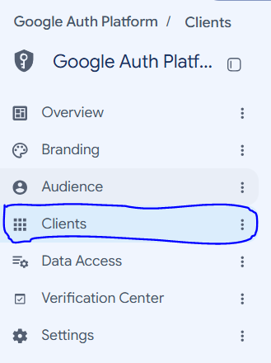
Go to google cloud platform console
  https://console.cloud.google.com/auth/overview

Slide 3
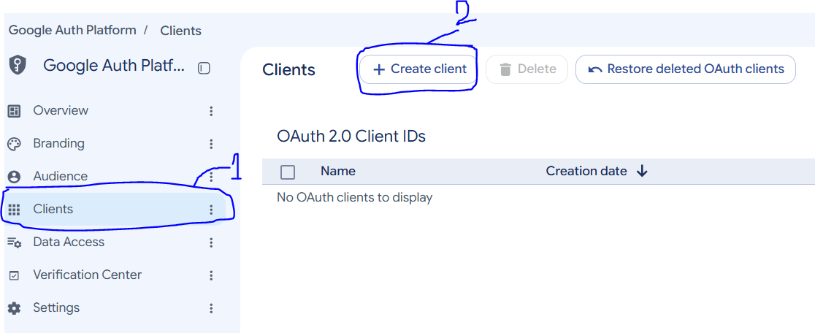
Go to google cloud platform console
  https://console.cloud.google.com/auth/overview
Create OAuth 2.0 Client ID with type web application

Slide 4
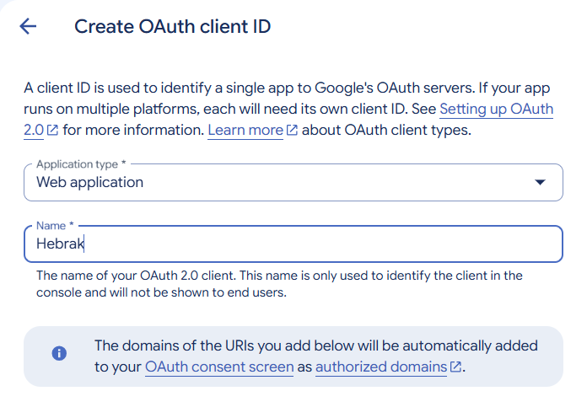
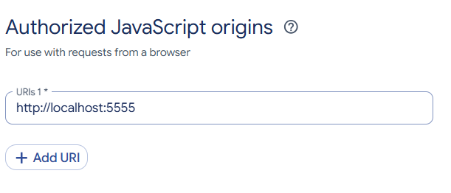
Authorized JavaScript Origins
- which site is allowed to use Google login
- for example of you have an angular site that works on http://localhost:4200
- http://localhost:5555/

Slide 5
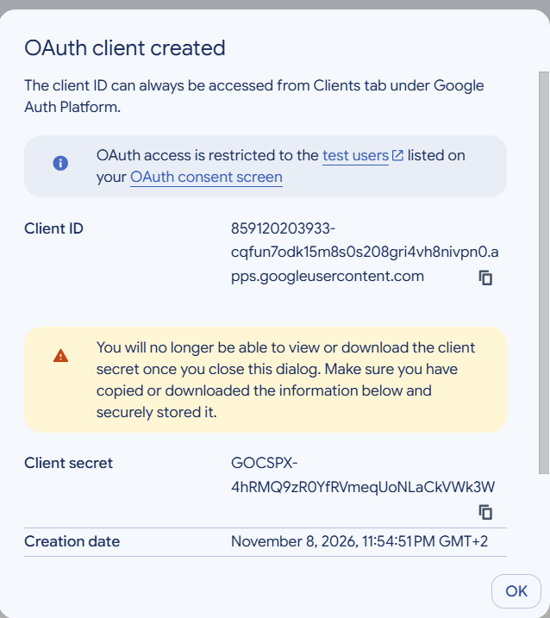
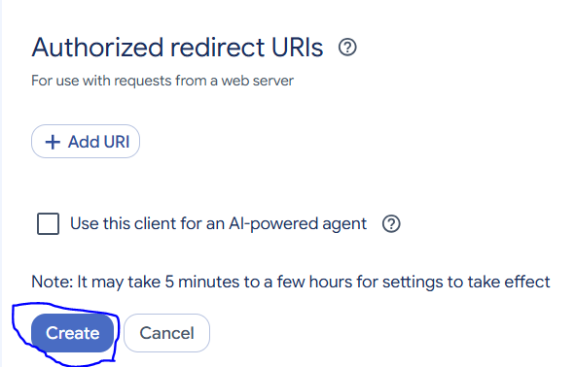

Slide 6
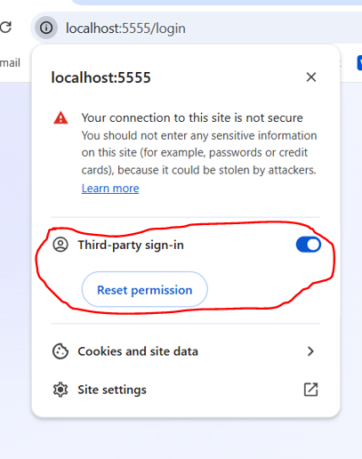
Ensure your site allo third party sign-in

